Slide 1
Flight price prediction project
Submitted by:
Rohit Kattewar

Slide 2
Introduction
Business Problem Framing:
Anyone who has booked a flight ticket knows how unexpectedly the prices vary. The cheapest available ticket on a given flight gets more and less expensive over time. This usually happens as an attempt to maximize revenue based on -
1. Time of purchase patterns (making sure last-minute purchases are expensive)
2. Keeping the flight as full as they want it (raising prices on a flight which is filling up in order to reduce sales and hold back inventory for those expensive last-minute expensive purchases)
So, we need collect data of flight fares with other features and work to make a model to predict fares of flights.

Slide 3
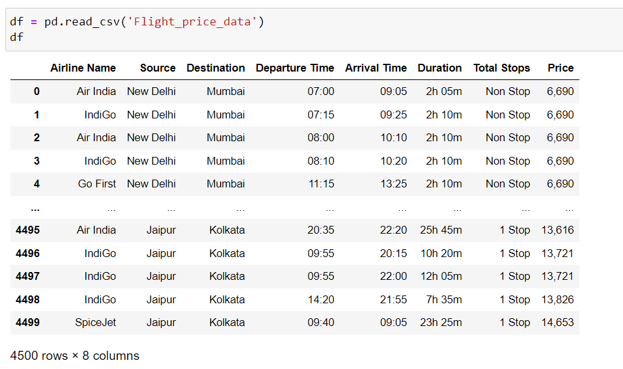
Dataset

Slide 4
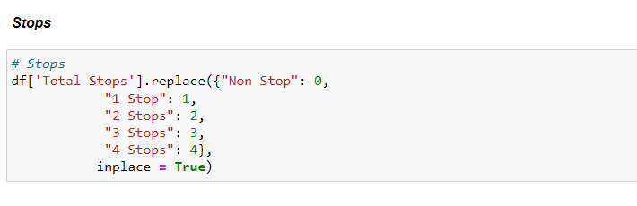
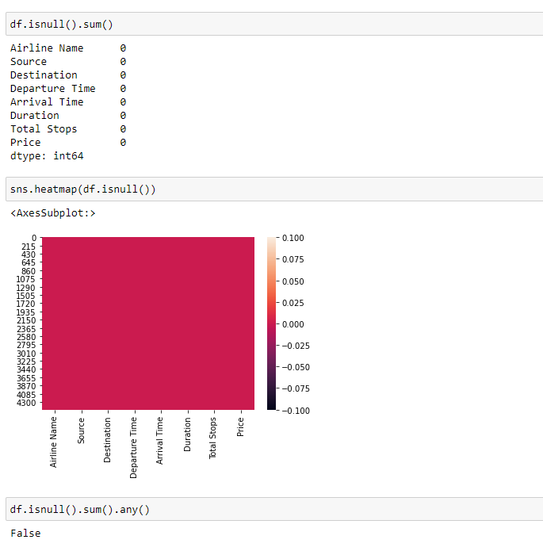
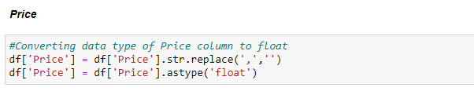
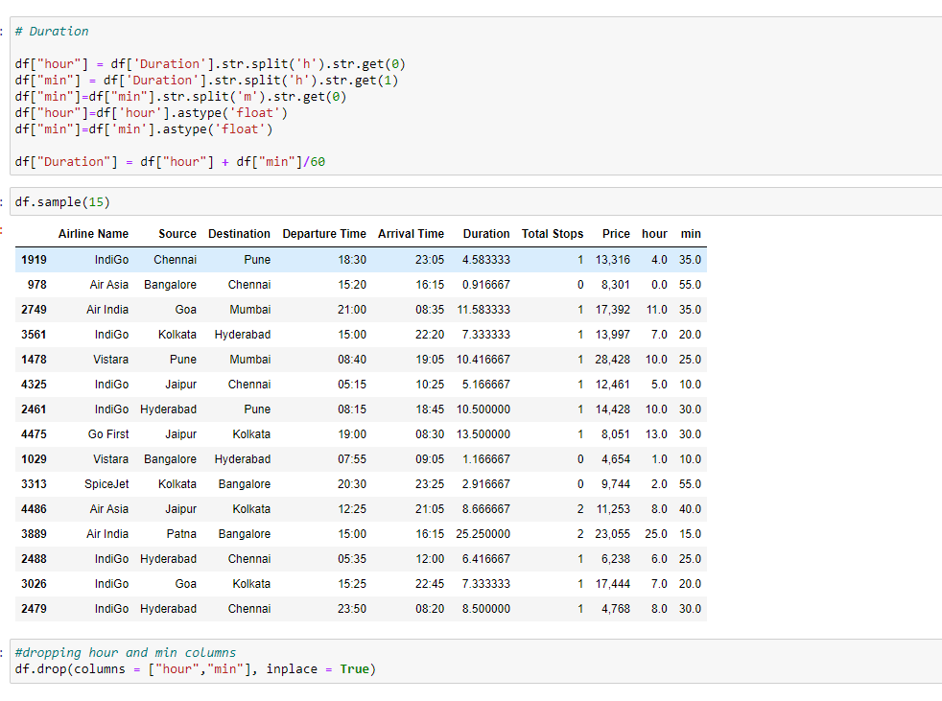
Data pre-processing

Slide 5
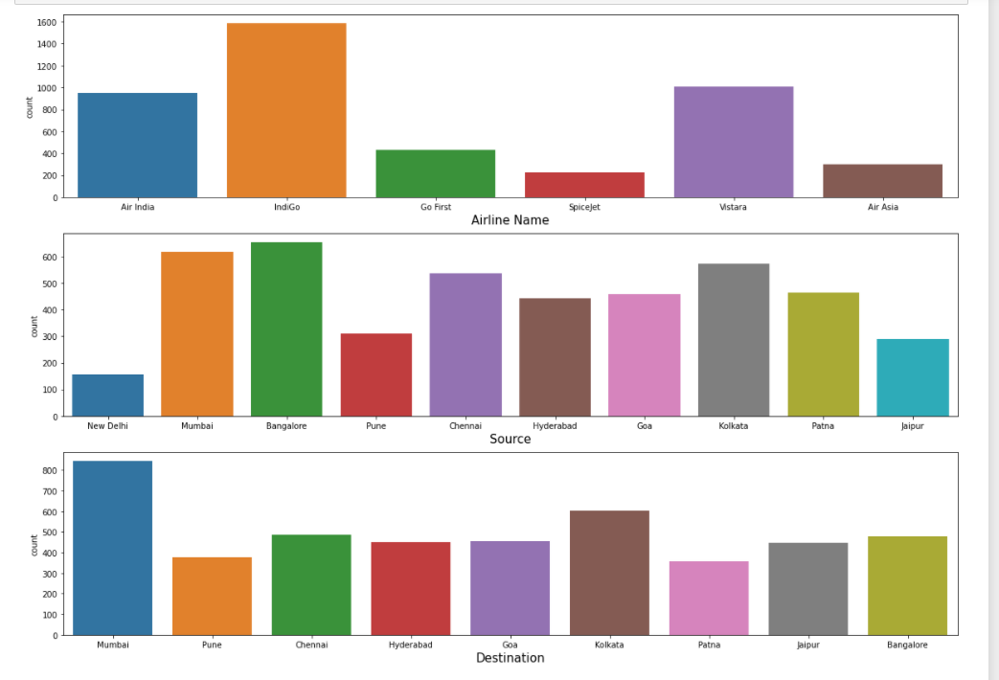
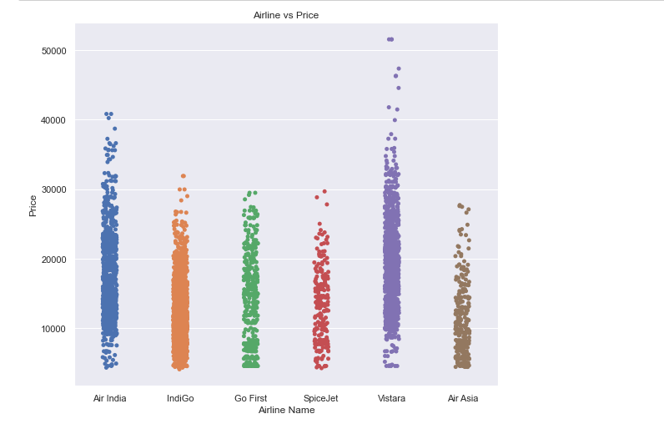
Visualizations

Slide 6
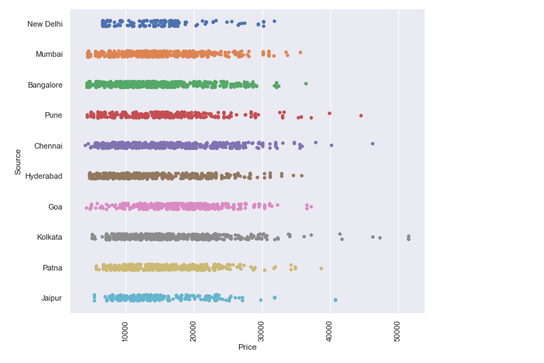
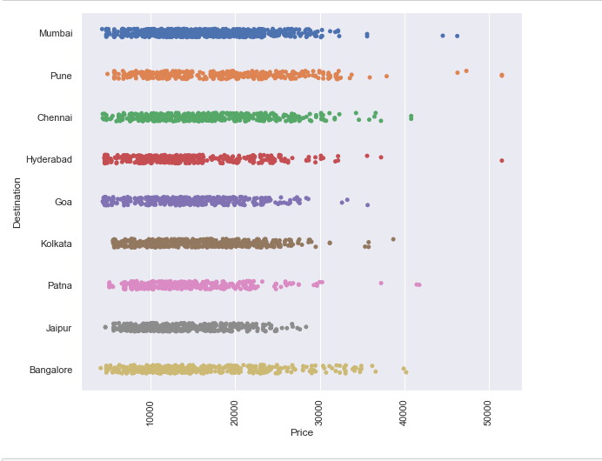
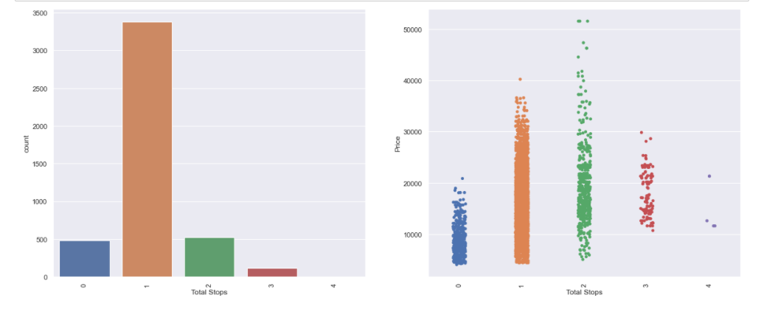
Visualizations

Slide 7
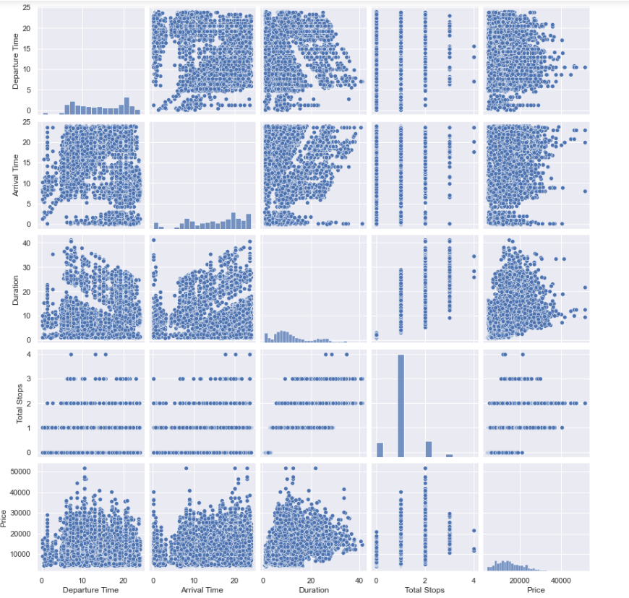
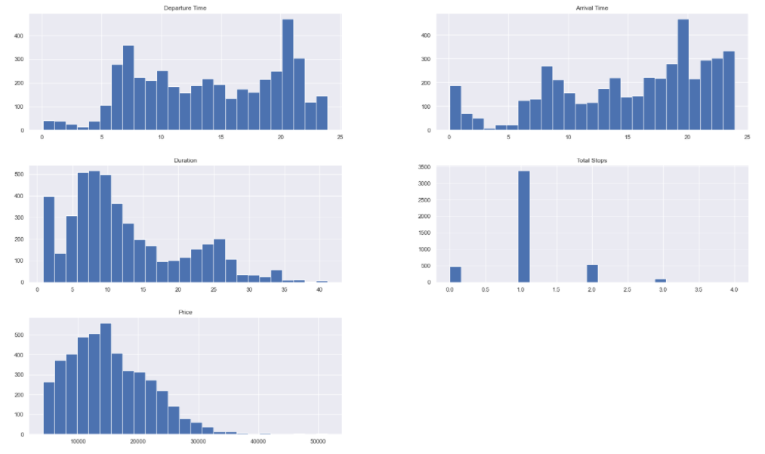
Visualizations

Slide 8
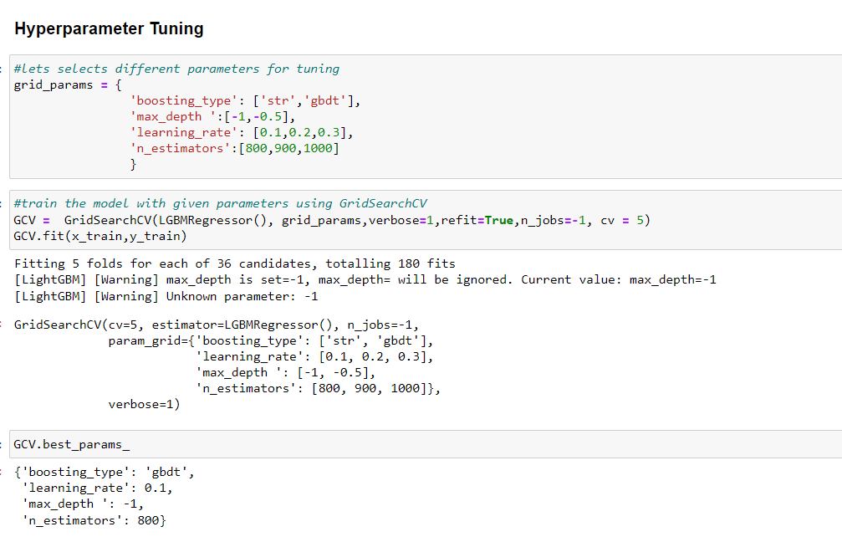
Model building: WE are finalizing LGBM regressor as out best model

Slide 9
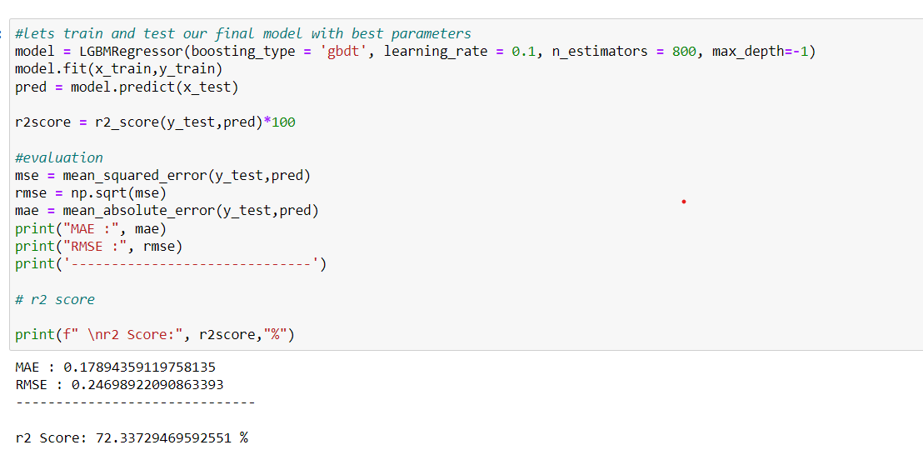
Results: Our model is giving 72.33% accuracy.

Slide 10
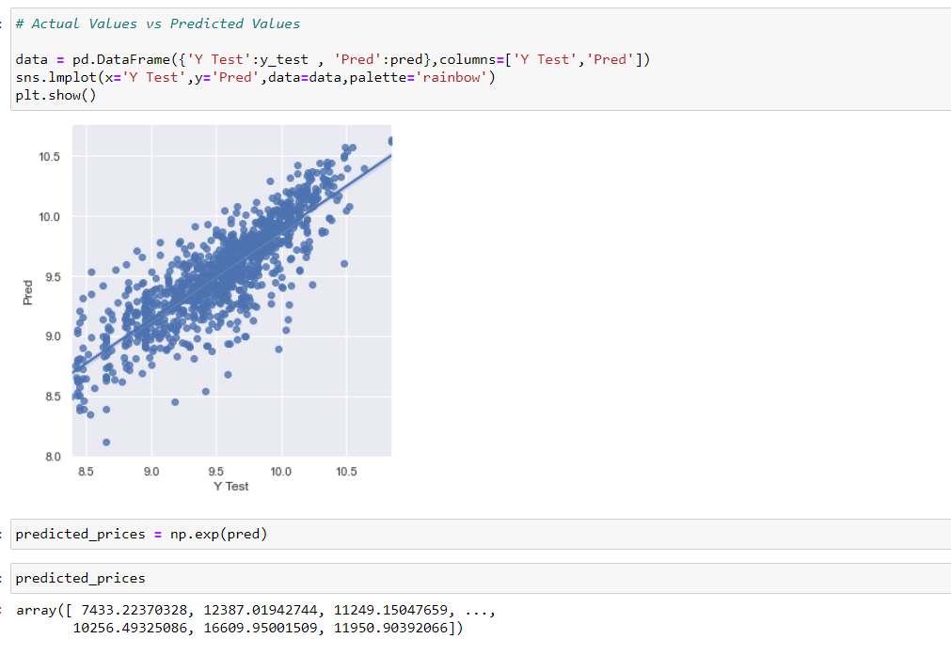
Predicted values

Slide 11
conclusion
Based on the in-depth analysis of the Flight Price Prediction Project, The Exploratory analysis of the datasets, and the analysis of the Outputs of the models the following observations are made:
Air Fare attributes like Date, Month, Duration, Total Stops etc play a big role in influencing the used Flight price.
Airline Name also has a very important role in determining the used Flight Ticket price.

Slide 12
conclusion
Due to the Training dataset being very small, only very small amount of the outliers was removed to ensure proper training of the models.
Therefore, Random Forest Regressor, which uses averaging to improve the predictive accuracy and controls over-fitting. performed well despite having to work on small dataset and produced good predictions that can be understood easily.
Data cleaning was a very important step in removing plenty of anomalous data from the huge dataset that was provided.
Visualising data helped identify outliers and the relationships between target and feature columns as well as analysing the strength of correlation that exists between them.

